Slide 1




DIGITAL LITERACY
SKILLS
ADVANCED USERS

Slide 2
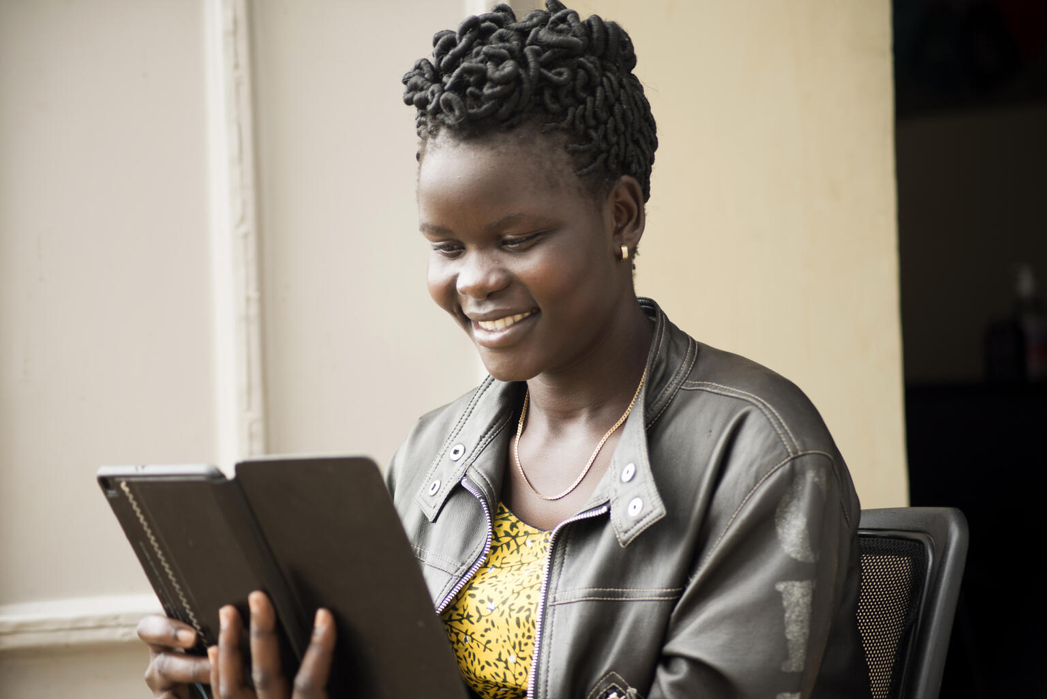
Module 2
Information processing

Slide 3

3
Unit 3: Managing data, information and digital content

Slide 4

Devices to save and retrieve information
Memory and Storage Devices
ROM (Read Only Memory)
RAM (Random Access Memory)
Memory card
USB Stick
Internal hard drive
External hard drive
Cloud storage

Slide 5

Skills to practise
Research new methods of information storage and retrieval.
Save information in different formats.
Copy and save this photo as a .JPG and a PDF.
Use a cloud storage service.
Save the photo in google docs.

Slide 6
All back covers should include
contact information of the section
producing the work.
© United Nations Children’s Fund (UNICEF) [month and year of publication]

